Slide 1
Allelic variation (SNPs) in populations and species
• Understand the concepts of alleles and gene flow
• Understand the mechansms by which gene flow between populations can be reduced or stopped
• Understand the concepts heterozygosity and homozygosity and how they can be used to study populations or speciation
• Understand the concepts undlying HWE and Fst analysis

Slide 2
Lecture Overview
• alleles
• population structure and gene flow
• genes, speciation and hybrid zones
• DNA barcoding
• genes and biogeographical processes
• genes and the coalescent process
• measuring variation in populations, HWE and Fst

Slide 3
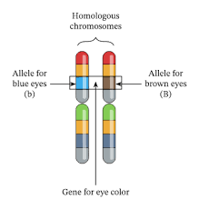
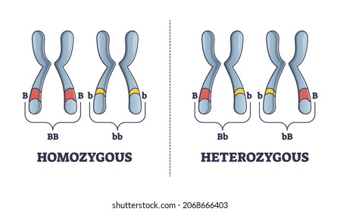
Alleles-heterozygous verses homozygous
• alleles are differences in nucleotide sequence between individuals in the same or different populations. They may display a phenotype but often don’t. Many are SNPs

Slide 4
Calculating allele frequencies
Genotypes | AA | Aa | aa | Total
No. individuals | 6 | 20 | 14 | 40
Genotype frequency | AA/Total 6/40=0.15 | Aa/Total 20/40=0.50 | aa/Total 14/40=0.35 | Total = 40 Total = 1

Slide 5
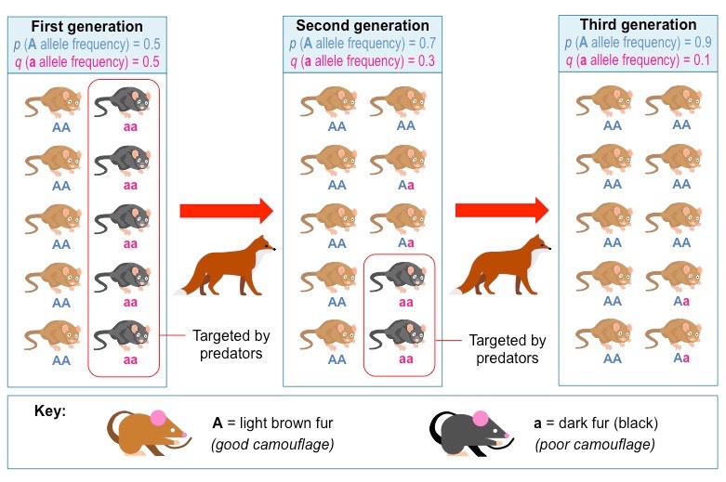
Allele frequencies drift v selection
• alleles can ‘drift’ to fixation without selection-the time taken for this to occur is dependent on population size and generation time (see later in lecture)
• alleles can be fixed more rapidly if selection is acting on them
• fixation= one of two alleles is lost, whereas the other becomes fixed
• e.g. imagine in the future that every human had brown eyes…

Slide 6
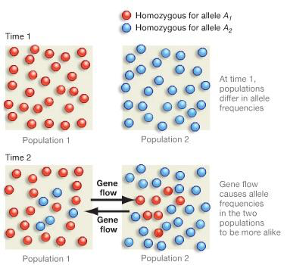
Population structure and gene flow
• alleles evolve via mutation, drift and sometimes selection. That is to say that two populations that are ‘separated’ (via some sort of ‘barrier’) will eventually produce/evolve different alleles that may drift to fixation, given time and the absence of gene flow

Slide 7
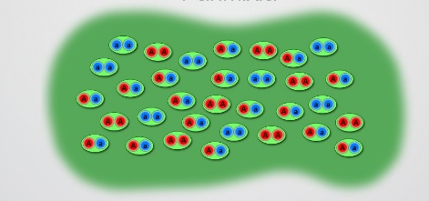
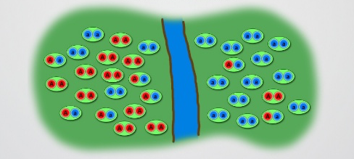
• or in the other direction
Random mating
Formation of a
barrier and
subsequent
differentiation

Slide 8
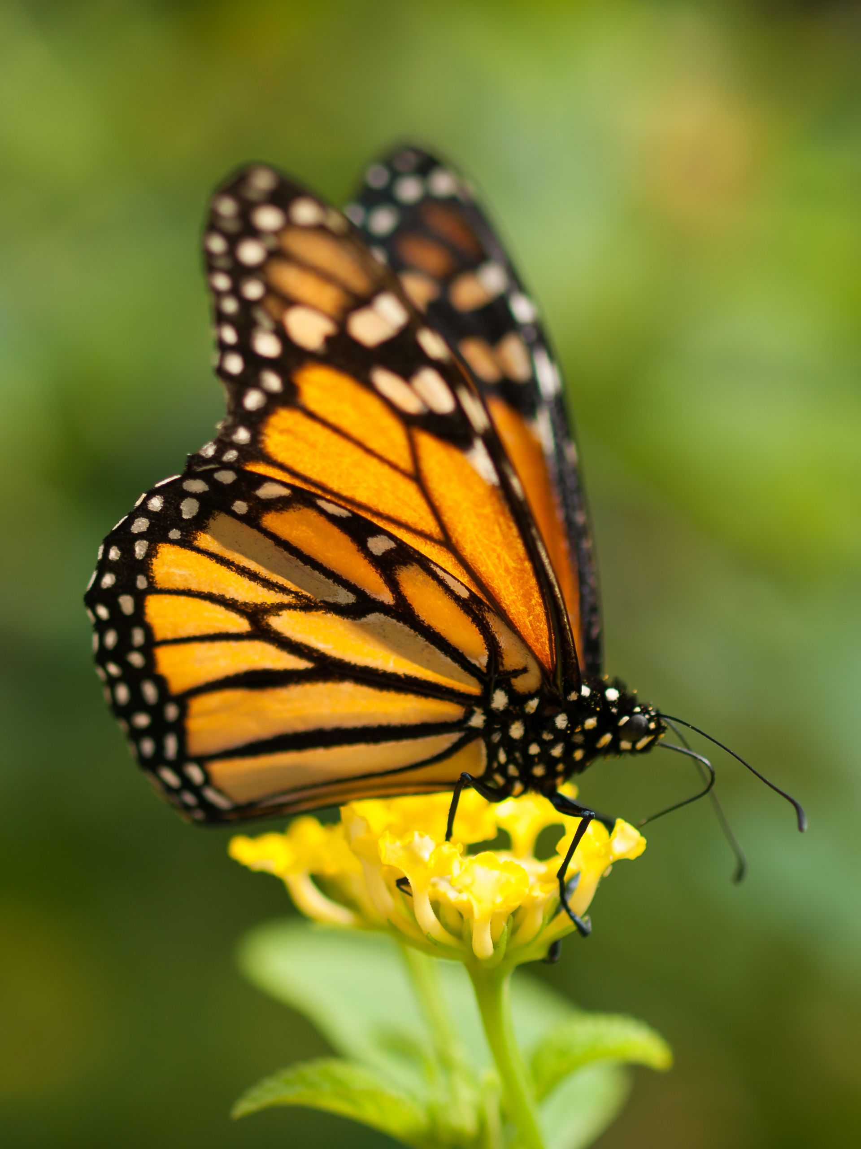
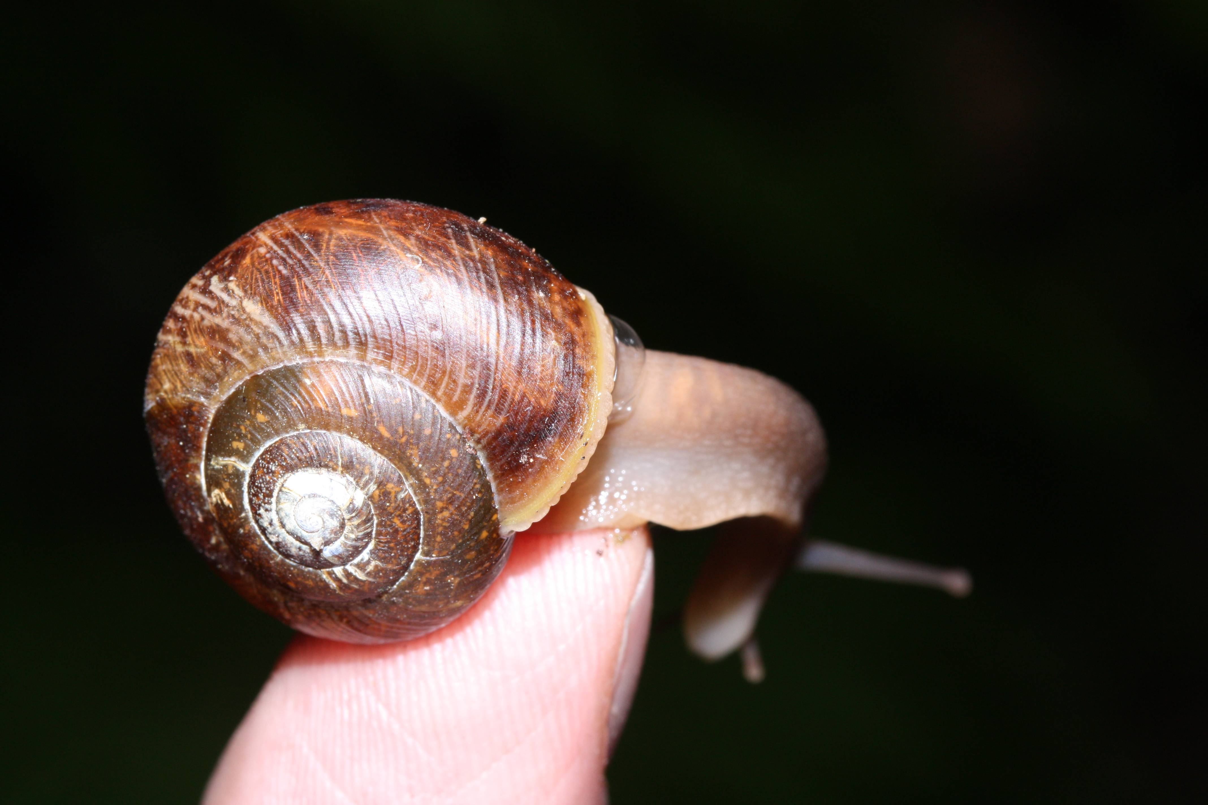
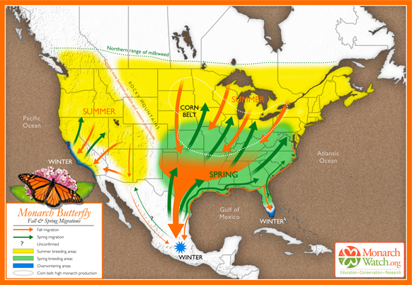
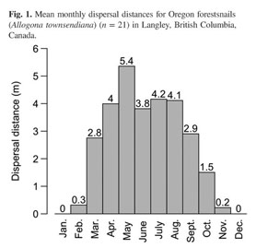
A ’barrier’ via dispersal and
gene flow
• land or forest snails
• monarch butterflies
• anything that interrupts gene flow can cause populations to differentiate
• i.e. populations start to vary in allele frequency at certain genomic positions or even fix different alleles entirely given enough time
Notes:
Populations vary over 10s of meters in the case of forest snails but over much larger distances in monarch butterflies

Slide 9
Physical barriers to gene flow
• clue: similar population structures in several
unrelated species
• thus alleles (mutations) can become fixed in different populations, leading to divergence (see later in lectures how quickly this occurs)

Slide 10
• location of genotypes

Slide 11
Behavioural barriers to gene flow
• natal homing
in turtles
• given enough time barriers to gene flow can result in speciation

Slide 12
Distribution of alleles and
population structure
• the overall variation and frequency of alleles
within a population can be studied rather than
their distribution
• by chance, the ‘white’ allele does not make it through the bottleneck

Slide 13
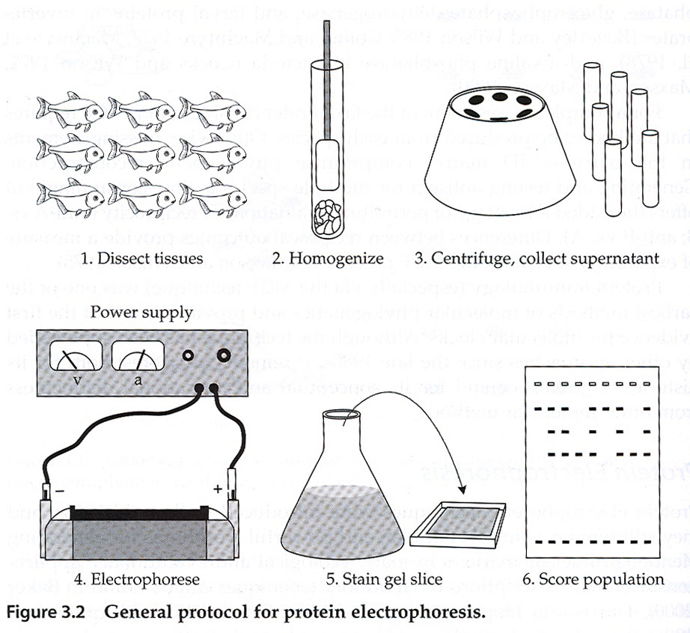
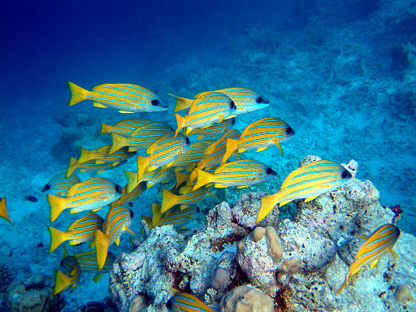
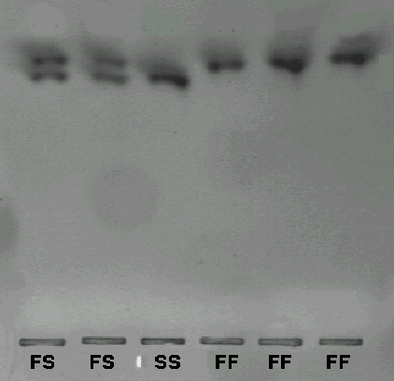
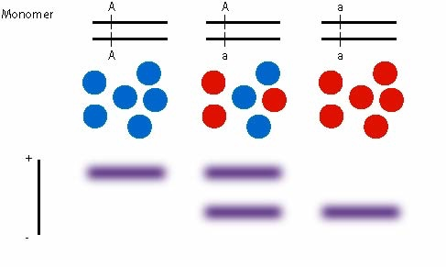
Sampling and genotyping a population-allozyomes
Jim and Becca Wicks [CC BY 2.0}
Large randomly-mating populations contain a lot of genetic diversity
F = allele A
S = allele a

Slide 14
• population bottlenecks within lions
• heterozygosity (i.e. allelic variation) reduces when population numbers are small)

Slide 15
Genes, Speciation and hybrid zones
• genes can be used to investigate speciation events and determine by what mechanism speciation is likely to have occurred
• some common blocks to gene flow which can lead to (or maintain) speciation (some of which I discussed earlier) are summarised on the following two slides

Slide 16
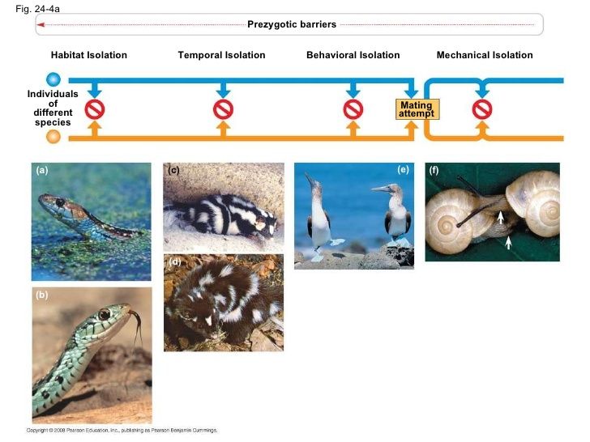
Notes:
Habitat- some Garter snakes prefer water, others land
Temporal-Western spotted skunk mates in Summer and Eastern spotted skunk mates in Winter, despite their overlapping host ranges
Behavioral-Blue footed booby has an elaborate dance-dance well and get accepted, otherwise get rejected. Other related boobies can’t dance correctly so get rejected.
Mechanical isolation-opposite chirality prevents mating in some snails

Slide 17
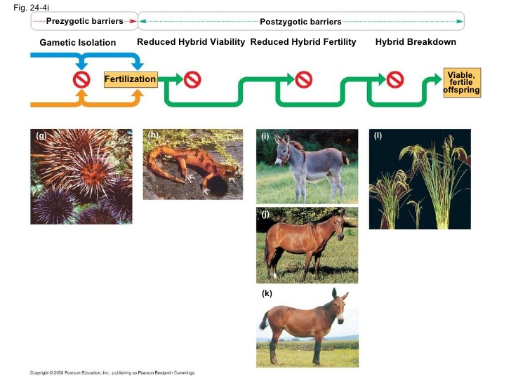
Notes:
Sea urchins show gametic isolation-can be caused by molecular mechanisms
Some salamanders showed reduced hybrid viability (but then again, some show hybrid vigour!)
The classic donkey and horse hybrid=sterile (almost always) mule
Hybrid breakdown is common in plants such as cotton, legumes and rice

Slide 18
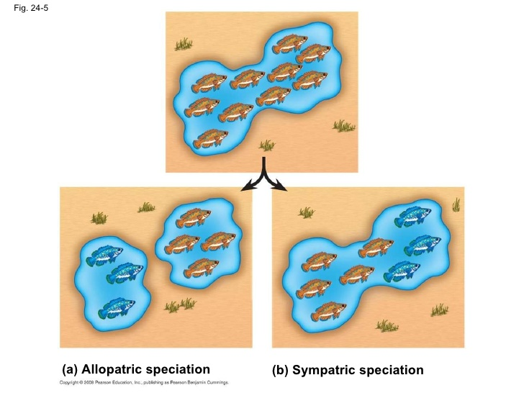
allopatric speciation

Slide 19
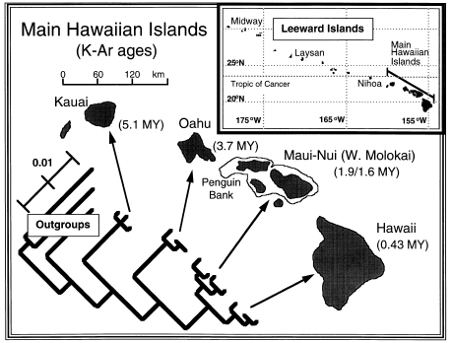
• allopatric speciation (many species of animals and plants follow this distribution, at least partially). Caused by an interruption of gene flow
Notes:
For an example see: https://nature.berkeley.edu/~gillespie/Publications_files/JArachnol2005.pdf
But there are lots of others

Slide 20
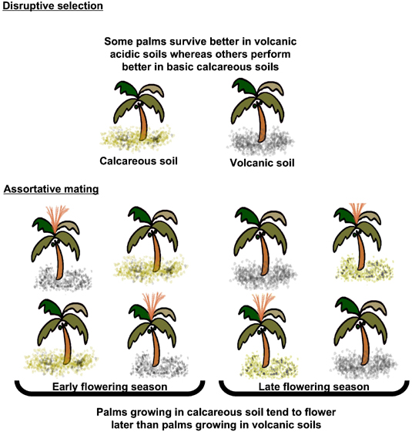
• sympatric
speciation
Notes:
From one of our own at Imperial: https://www.nature.com/articles/nature04566

Slide 21
• parapatric speciation
• usually involves a hybrid zone (heterozygous alleles)
Notes:
For a recent explanation you could look at: https://www.researchgate.net/publication/333469312_Speciation_and_hybridization_in_invasive_fire_ants
However, the slide above is simple and gives the take-home message I want to get across

Slide 22
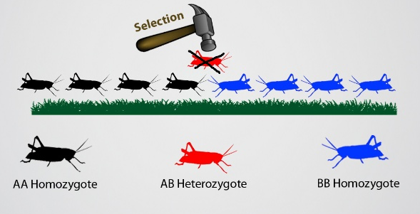
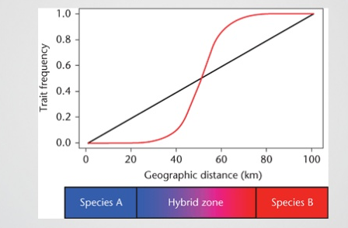
• in these cases selection acts against the hybrids
• i.e. gene flow is not able to penetrate into the other population

Slide 23
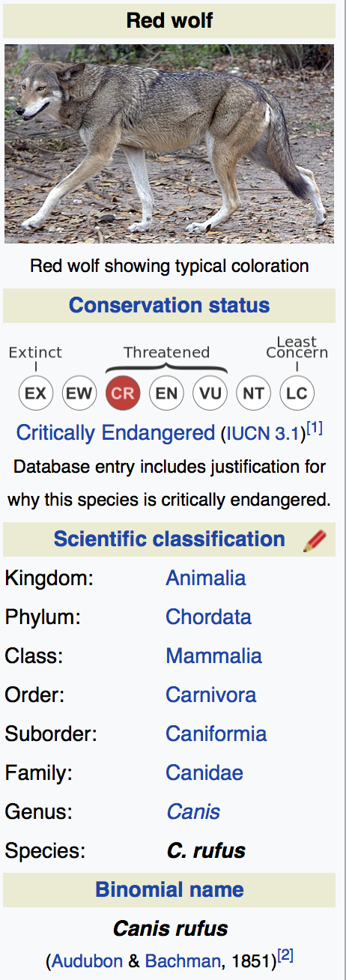
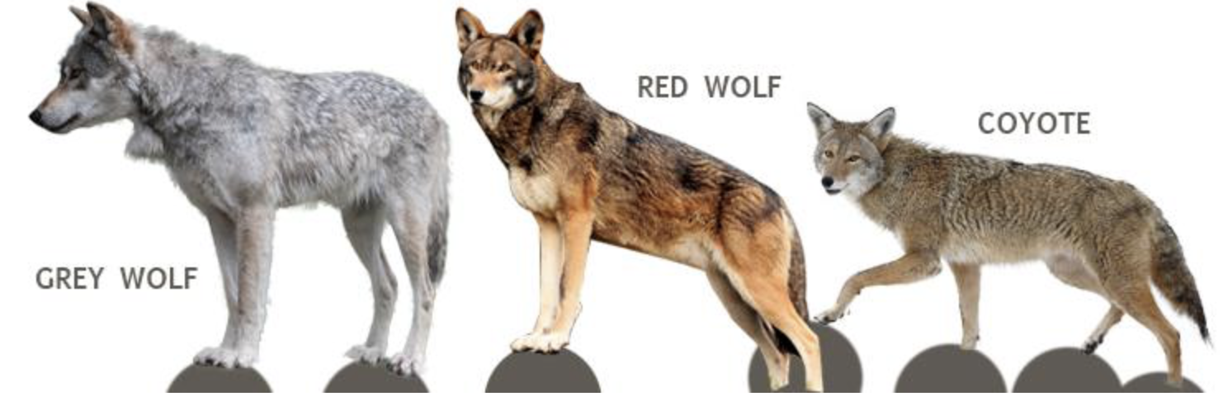
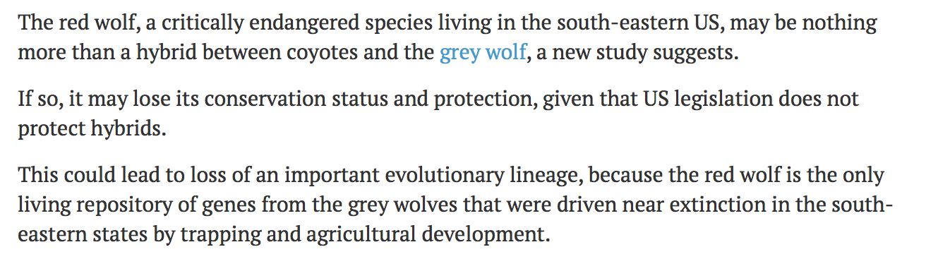
• An interesting example of speciation?
(or mere hybridization??)
Above text from New Scientist 27th July 2016
Based on:
Science Advances, DOI: 10.1126/sciadv.1501714

Slide 24
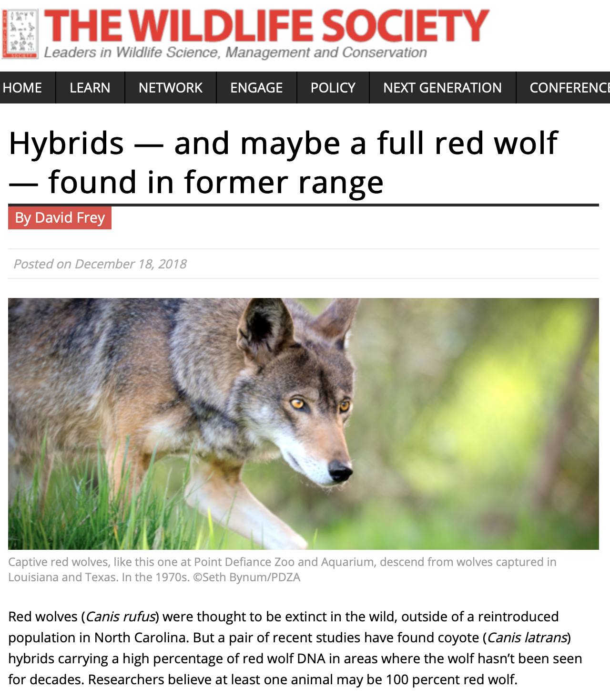
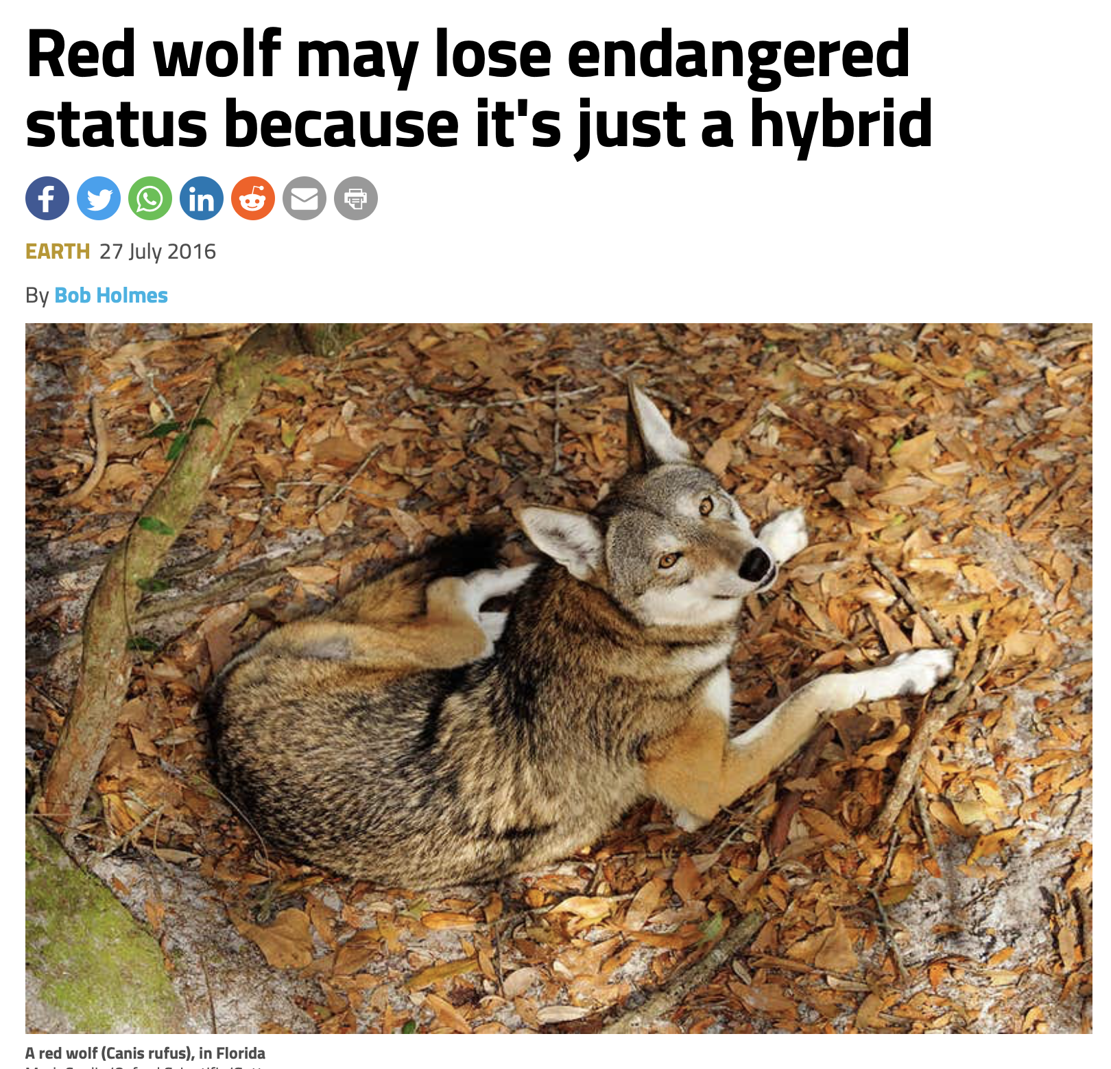
• why is this important?
• lots of continuing argument as to whether it is a real species, a hybrid, or maybe a hybrid containing genes once belonging to a now extinct (red) wolf?
• One study suggested hybrids first appeared around 300 years ago (based on SNPs)
• looks like the argument might continue a while….
Notes:
I am sure you will find lots of papers stating that either (i) the red wolf is a genuine species and (ii) it is not a genuine species. This controversy is occurring despite huge amounts of available sequence information being available!

Slide 25
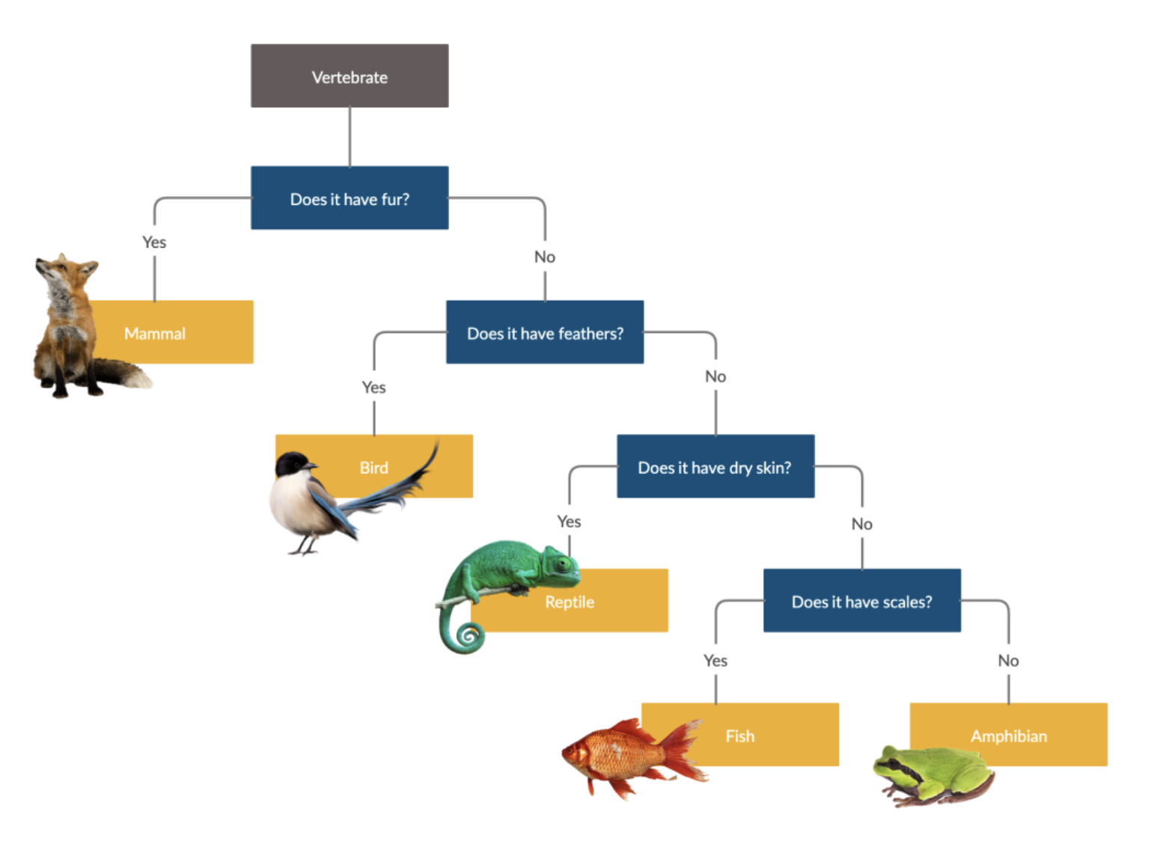
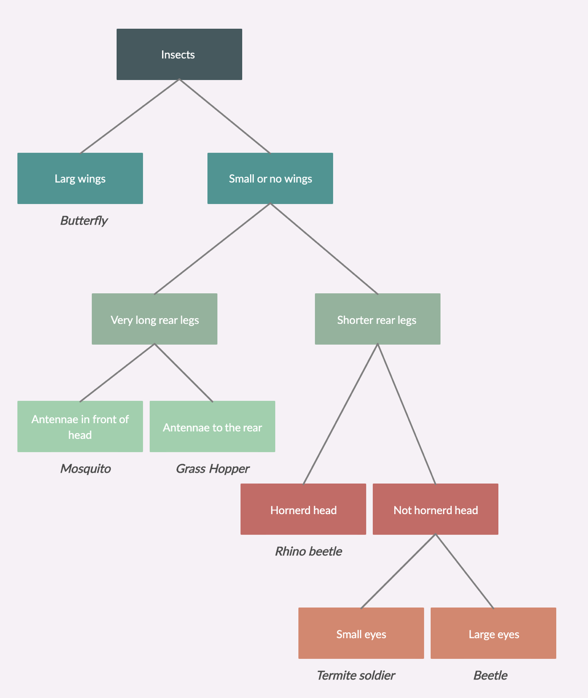
DNA Barcoding
• Genes can help identify taxa
• How can you identify an organism to species level……
• Well, we previously used dichotomous ‘keys’
• These are obviously really simple (and likely inaccurate and subjective)
• Keying beetles for example to species level is rather more complex (more than 300,000 known species)

Slide 26
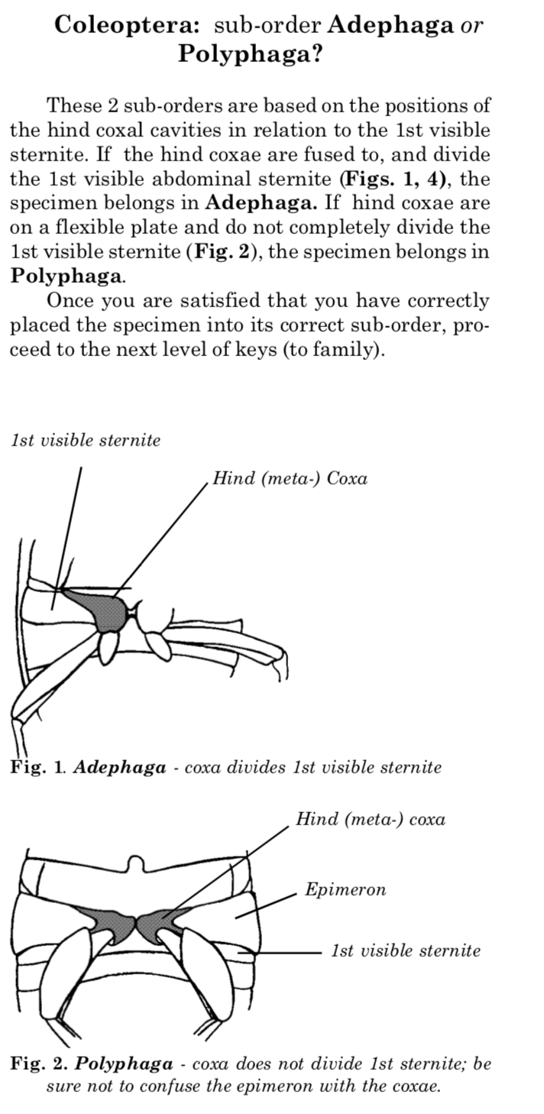
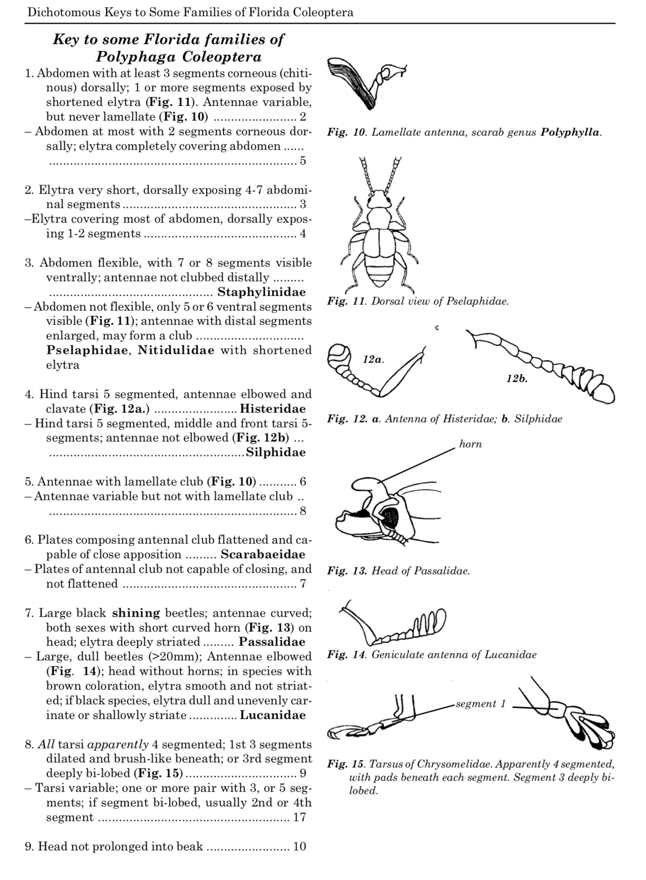
• you don’t need to know this-my point is it is REALLY complex

Slide 27
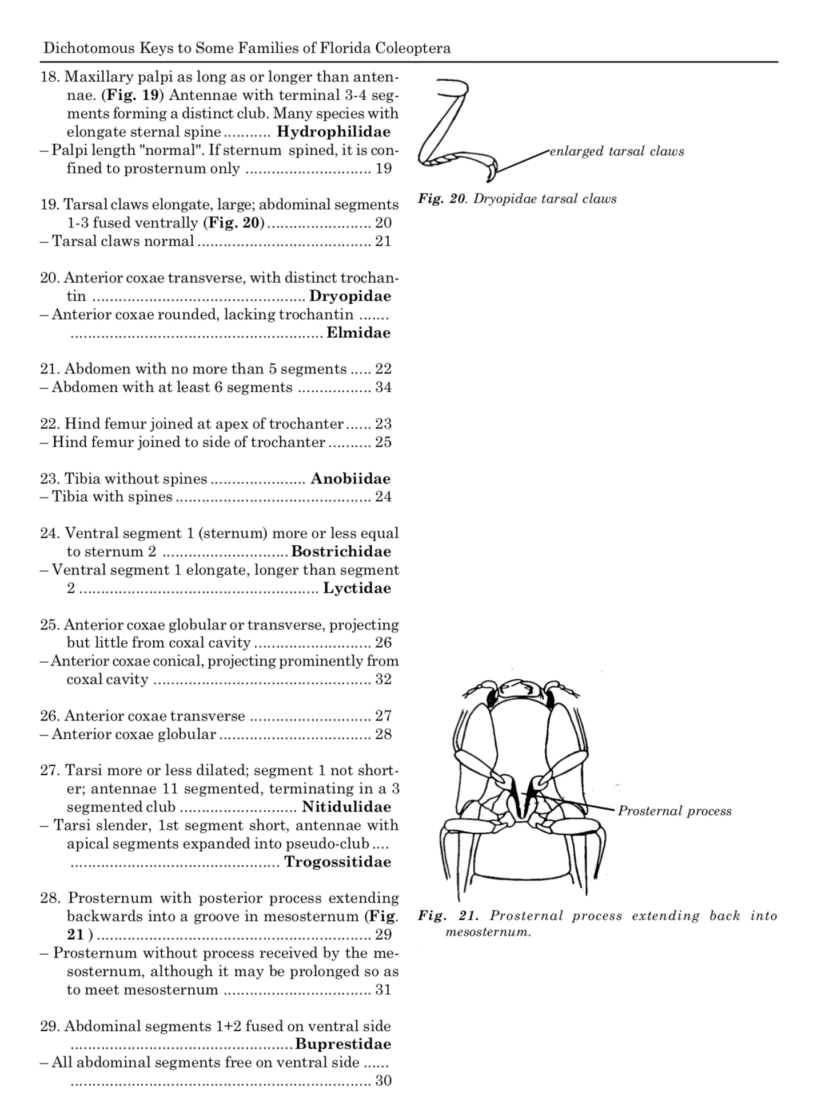
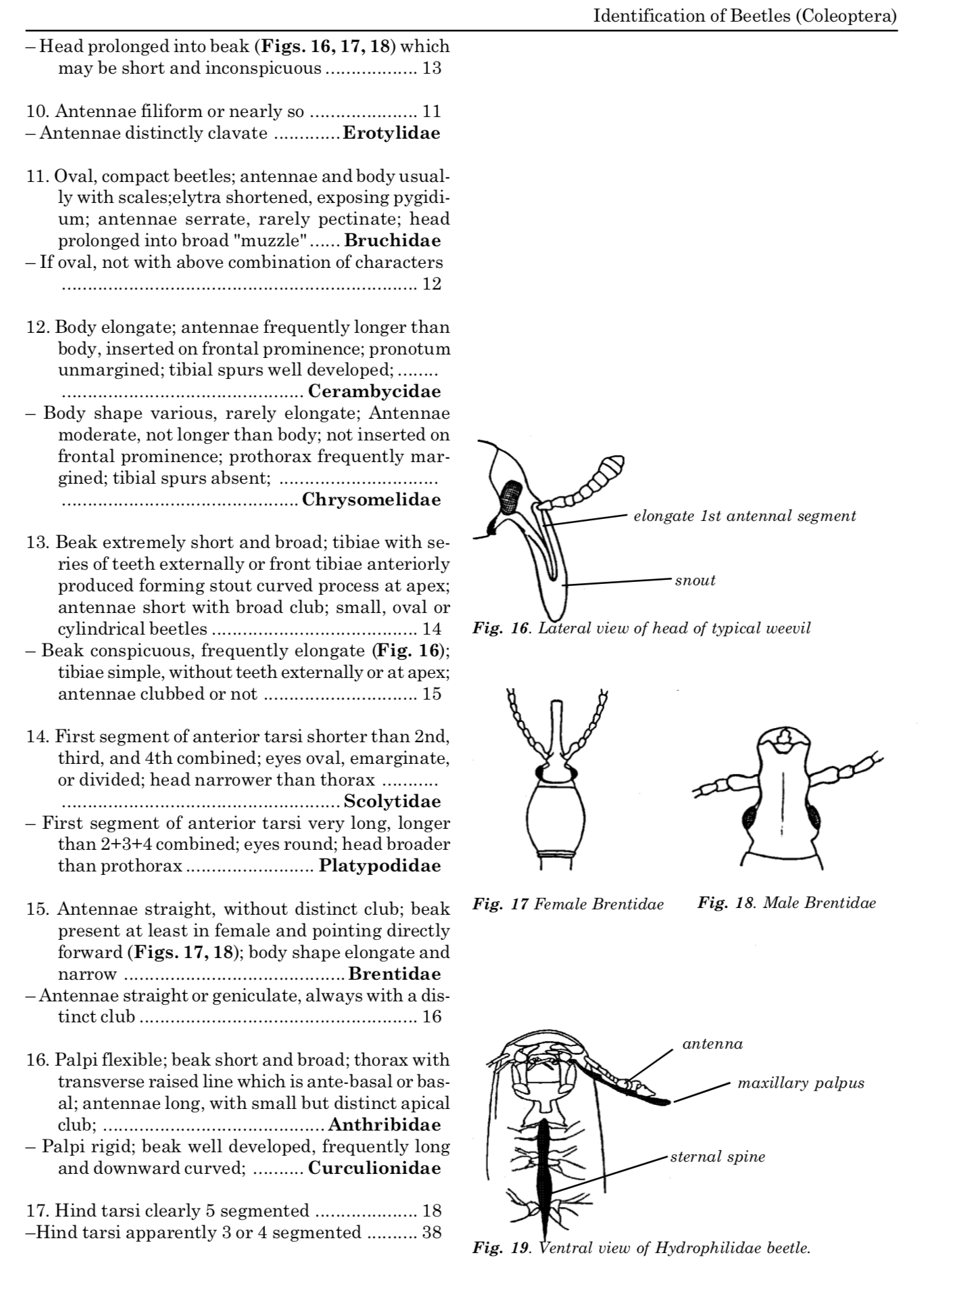
• the key continues for several more pages and this just identifies to family level-nowhere near a species level identification! (please don’t revise this!)
• Take home message is that you would need a world expert, with decades of experience to identify specific species. Is there an easier way……..?
Notes:
In the past only a few academics (often based in museums) would be able to identify/key out your species for you. You might have to wait six months for a reply….
That is not much use if you are a farmer with an acute pest problem

Slide 28
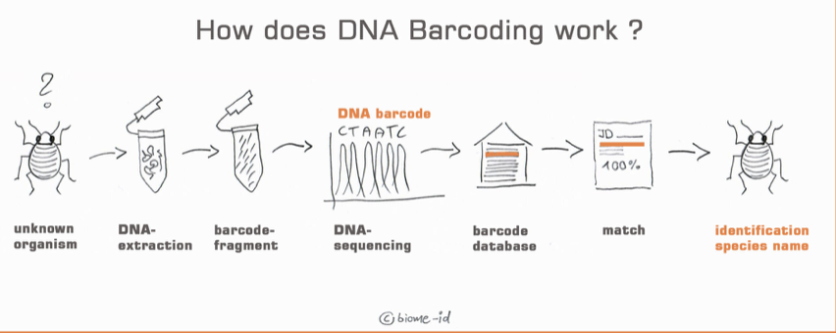
• thankfully there is, via Barcoding
• usually done via PCR with ‘barcoding’ primers
• primers often designed against very conserved regions of cytochrome oxidase (COX1) or regions of rDNA (or other genes)
• the internal region (~500bp), between the primers, is highly variable, each species thus has a unique sequence or ‘barcode’
• compare the generated sequence against a bioinfomatics database to identify your species of interest

Slide 29
Genes and biogeographical processes
• genes can provide insights into
(i) short term migrations of populations such as humans
(ii) longer term geographical and
evolutionary processes

Slide 30
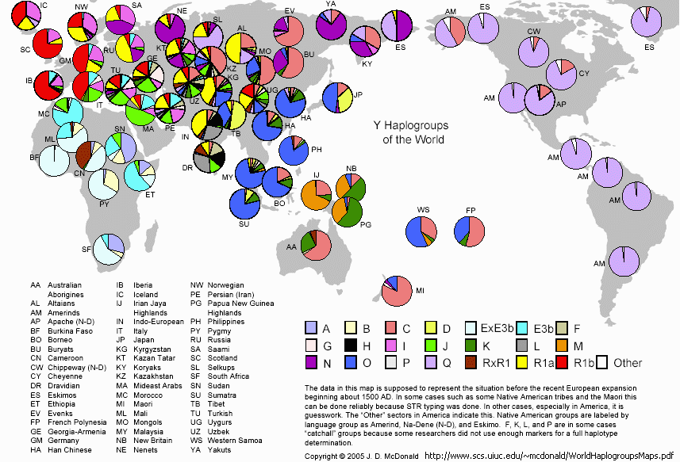
Patterns of migration-humans
• recent migration patterns can be investigated using haplogroups-basically one or more SNPs/alleles that differ between human populations (the more recent maps are even more complicated!)
Notes:
• This is a quite old map-the new ones are really complicated and are far too complex to present in a few minutes.
Here is an example of the distribution of just one haplogroup if you are interested: https://www.nature.com/articles/srep46044

Slide 31
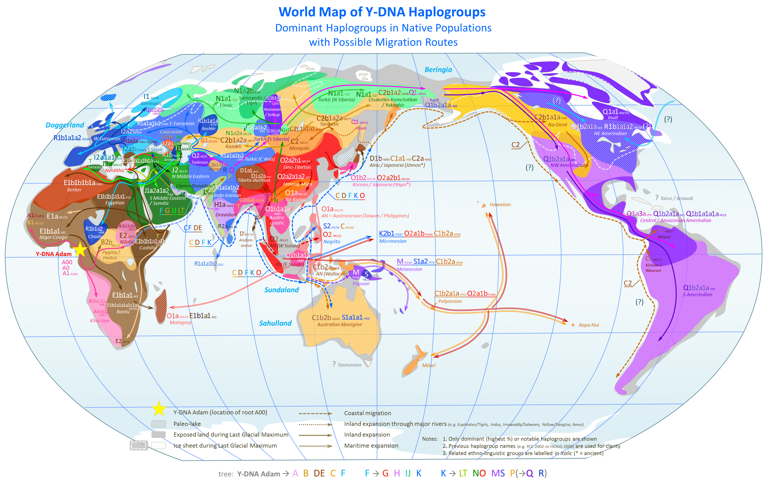
• can be converted into migration patterns
• based on nested phylogenies of SNPs

Slide 32
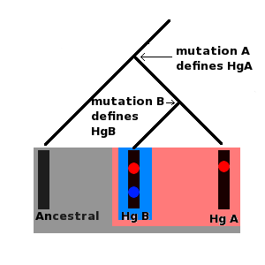
• Hg= Haplogroup
• Use Y chromosome or mtDNA data
• some haplogroups actually have many tens or even hundreds of shared SNPs
It gets rather complicated as many different Haplogroups can be found in the same area of the world and the same SNP can be given different names (based on which group or company discovered it), but I suggest the following site if you to explore:
https://www.eupedia.com/genetics/phylogenetic_trees_Y-DNA_haplogroups.shtml

Slide 33
Vicariance biology
• vicariance biogeography looks for relationships
between taxa and the geographic regions
they inhabit and is usually based on longer timescales
• a phylogeny of midge families

Slide 34
Gene genealogies and the
coalescent process
• The length of time since the allele originated is dependent on the population size (N)

Slide 35
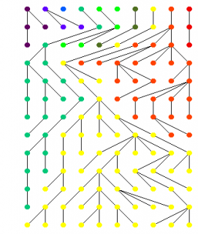
• larger population sizes have longer
coalescence times

Slide 36
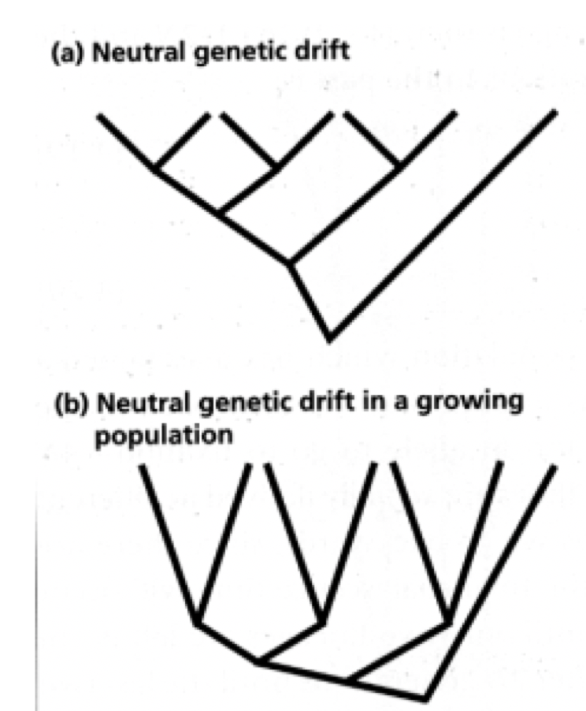
Coalescent theory and population size
estimates
• different population histories leave different
signatures on phylogenetic trees

Slide 37
Hardy Weinburg equilibrium
Allele frequencies in an ‘ideal’ or ‘equilibrium’ population do not change between generations
Thus there is no evolution and variation is maintained
For two alleles in a population whose allele frequencies are given by p and q,
the three genotype frequencies AA, Aa, aa will be given by p², 2pq and q², respectively

Slide 38
Genotypes | AA | Aa | aa | Total
No. individuals | 6 | 20 | 14 | 40
Genotype frequency | AA/Total 6/40=0.15 | Aa/Total 20/40=0.50 | aa/Total 14/40=0.35 | Total = 40 Total = 1
0.5 because only 50% of the alleles are A
Let p = Allele frequency of A
Let q = Allele frequency of a
Note that p + q = 1
• this is the observed frequency

Slide 39
Assumptions of HWE
Non overlapping generations; equal sex ratio
No migration in or out of the population
Random mating
No Selection: Equal survival and reproduction, fertility and fecundity of genotypes
No mutation
A ↔ a upon gamete formation
Infinitely large population so that individuals & their gametes can contribute equally i.e. no random genetic drift
• the expected allele frequencies can be calculated. If the expected and observed allele frequencies are significantly different then one or more of the conditions above have not been met

Slide 40
Now consider
Genotypes | AA | Aa | aa | Total
No. individuals | 20 | 20 | 0 | 40
Genotype frequency | AA/Total 20/40=0.5 | Aa/Total 20/40=0.50 | aa/Total 0/40=0.0 | Total = 40 Total = 1
or
Genotypes | AA | Aa | aa | Total
No. individuals | 0 | 40 | 0 | 40
Genotype frequency | AA/Total 0/40=0.0 | Aa/Total 40/40=1.0 | aa/Total 0/40=0.0 | Total = 40 Total = 1

Slide 41
Population structure measurement
• Differences in population structure can be measured in various ways including Fst (fixation index) analysis

Slide 42
Migration moves alleles
Fixed for white
allele
migration
migration
reduces or stops
migration
stops
Fixed for blue
allele
time
neutral loci such as allozymes/ microsatellite markers used to measure extent of allelic differentiation between populations due to drift by measuring levels of heterozygosity to estimate F_{ST}

Slide 43
What does F_{ST} mean?
F_{ST} value | Level of Differentiation
0 | No differentiation in allele frequency (or no. of heterozygotes) between subpopulations at this locus. All sub populations have same allele frequency as total population.
>0.0<0.05 | very little
0.05-0.15 | moderate
0.15-0.25 | great
>0.25 | very great
1 | different alleles fixed in different subpopulations at this locus
Notes:
Originally modelled for 2 alleles at the locus

